Slide 1
Commuters & Residence Life
Michaela Tuesburg, Assistant Director of Residence Life & Involvement

Slide 2
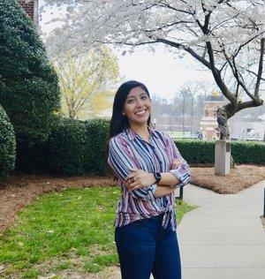
Meet The Staff
Diareth Flores
Director of Commuter Engagement
BARC
Bulldogs Activities Resource Committee
SGA
Student Government Association
Senators

Slide 3
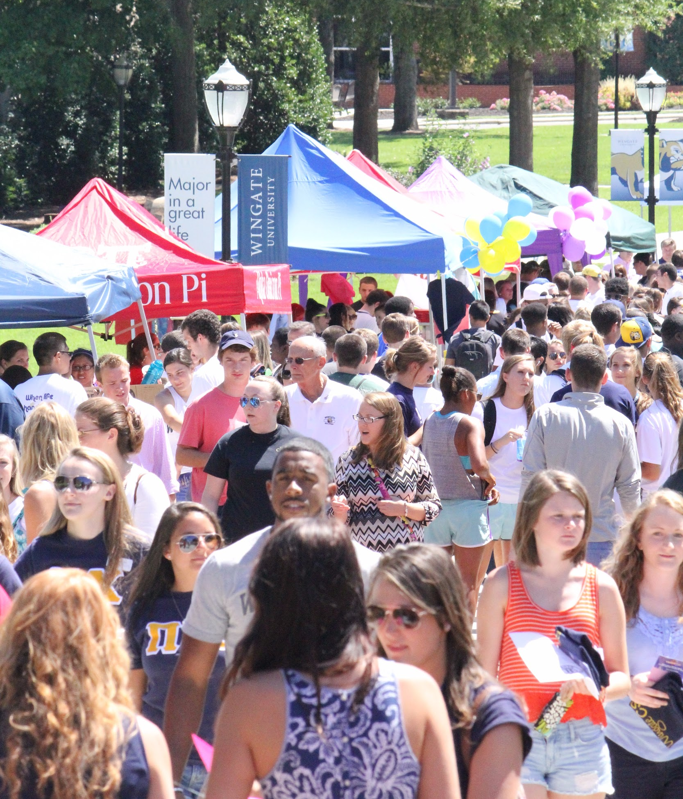
Getting Involved
Street Fair
Registered Student Organizations (RSO)
Greek Life
Intramurals
On-Campus Jobs
Community Service (One Day, One Dog)
Peer Mentoring/Teacher Assistant
Tailgating
SGA
WUSYNC Emails
...and More!

Slide 4
Resources
Library
Academic Resource Center (ARC) - writing center, tutoring, disability accommodations, student success
Stegall
Business Office, Registrar’s Office, Financial Planning
Internships and Career Services
Career Development and Internships
Health Center
Counseling Center
Campus Safety 704-233-8999

Slide 5
Commuter Spaces
Ethel K. Smith Library
Dickson Palmer Center - Starbucks
Burris Lounge
Austin Auditorium Lobby
McGee Center
Klondike
Neu Building

Slide 6
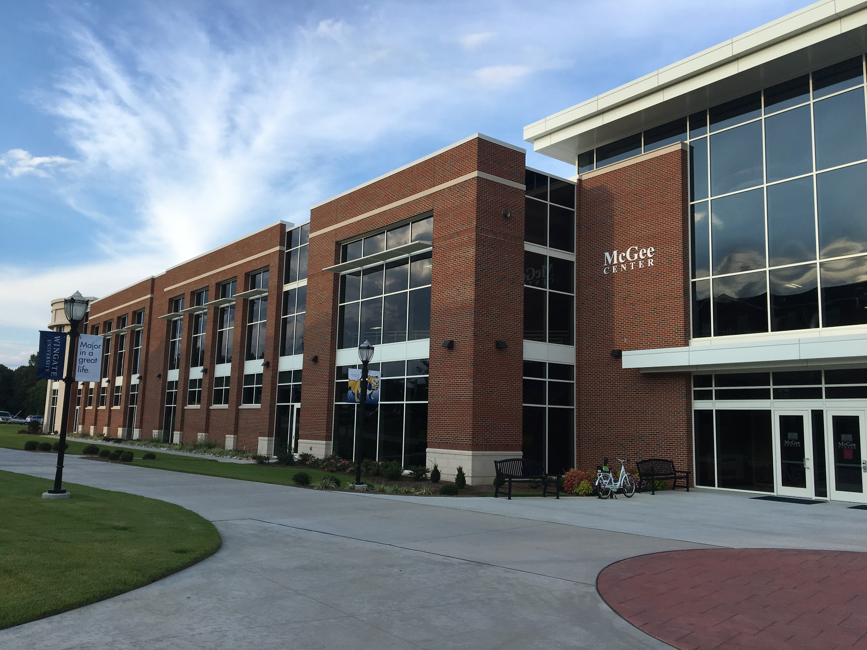
McGee Center
Group Fitness Classes
Personal Training
Showers
Sports Equipment Rental
Intramurals

Slide 7
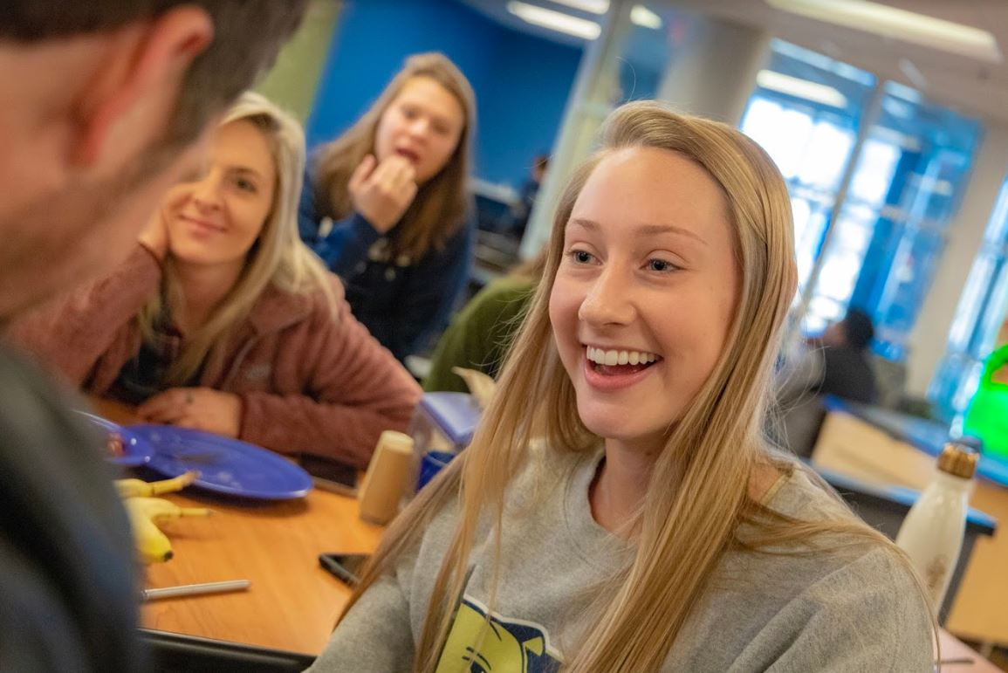
Meal Plans
W.T. Harris Dining Hall
Klondike
Starbucks
PODS
Einstein’s
Pizza Hut

Slide 8
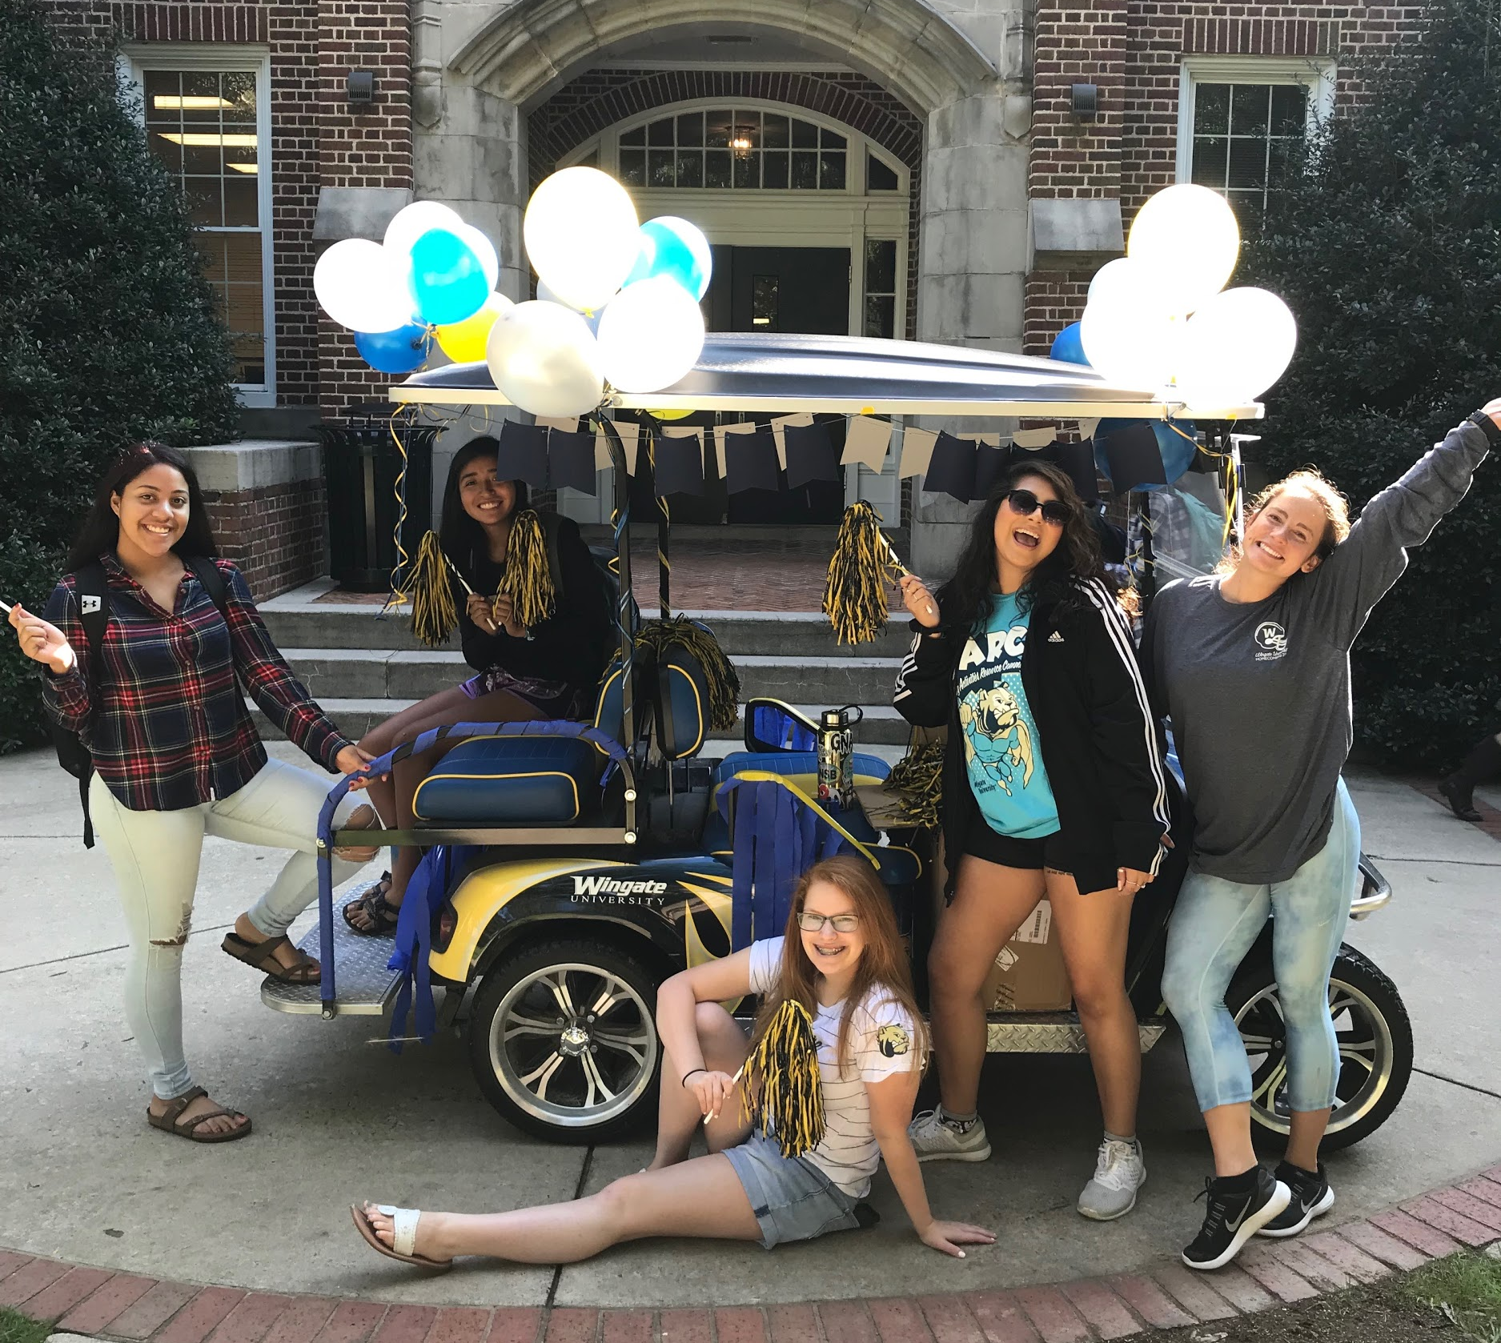
Parking
Commuter Lots - Identified as “C”
Campus Safety - Issues Parking Passes
Parking Violations
Appeal process through Honor Council

Slide 9
Communication
Emails
Social Media @WU_BARC
Instagram
Facebook
Twitter
Newsletters

Slide 10
Programming

Slide 12
Thank you!
Questions?
m.tuesburg@wingate.edu

